Slide 1
Roaming Around Latent Space
DS595 Final Project
Team: Yang Mo, Wenhao Qiu, Yixian Huang

Slide 2
Objective
Notes:
Hello everyone, in this project, we will talk about how to “PS” pictures by latent space.

Slide 3
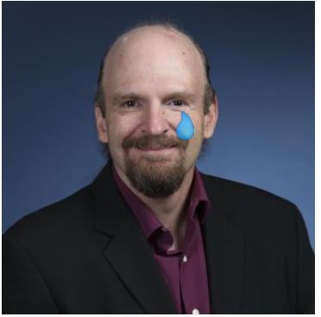
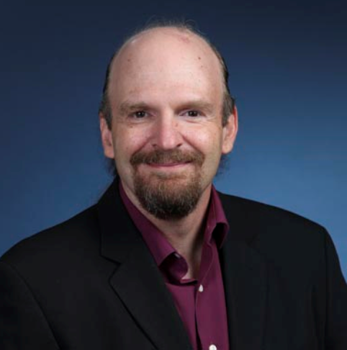
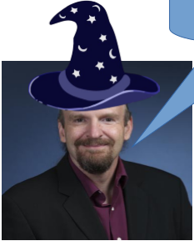
“PS”
Notes:
I think everyone has the experience of “PS” pictures. With some software, we can add a hat or glasses to our picture, change the color of hair, make the picture look more beautiful or do some similar operations like this. But all these operations are based on the original pictures and the objective of our project is to modify pictures by changing the latent space of the pictures.
Picture is the valuable that follows a joint distribution function of different features and the nonlinear dimension reduction model can give us the latent space of the original picture. Ideally, If there is a certain nonlinear dimension reduction model in which we could combine a continuous latent space with a continuous image space, we can change the latent space and then get a picture with different features in output.

Slide 4
Introduction

Slide 5

figure from Rohith Gandhi, Medium
Notes:
Unfortunately, we did not find this nonlinear dimension reduction model. However, GAN can satisfy this requirement. A generative adversarial network(GAN) is a class of machine learning systems invented in 2014. Two neural network contest each other in a game, the generative network learns to map from a latent space to a picture, while the discriminative network distinguishes candidates produced by the generator from the true image.
Typically, the latent space is a random noise from a certain distribution.
The training objective of GAN is to increase the error rate of the discriminator. In other words, we hope that the image produced by the generator can cheat the discriminator.
Our GAN train on CelebAHQ dataset, it is a human face dataset and each image in the dataset have 40 attributes.
Based on the generator of GAN, we could combine a continuous latent space with a continuous image space. But the images generated by GAN are random. They can be male or female, older or younger, long hair or short hair, with or without glasses. For a certain noise, what we do is that we control the features of image after generator network by changing the noise to certain direction.

Slide 6
Result

Slide 7
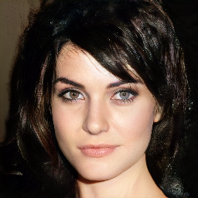
Notes:
this is picture generated by GAN, we cut her hair short

Slide 8
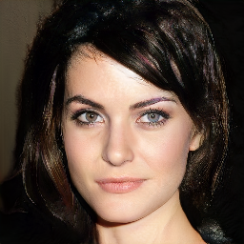

Slide 9
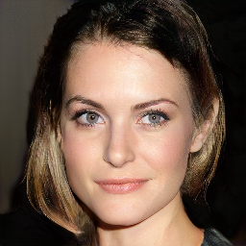

Slide 10
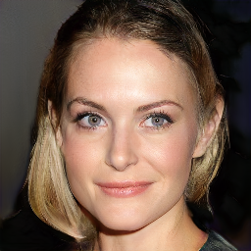

Slide 11
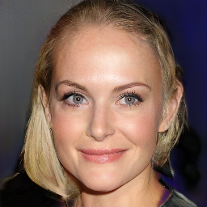

Slide 12
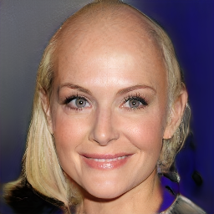
Notes:
The results are amazing

Slide 13
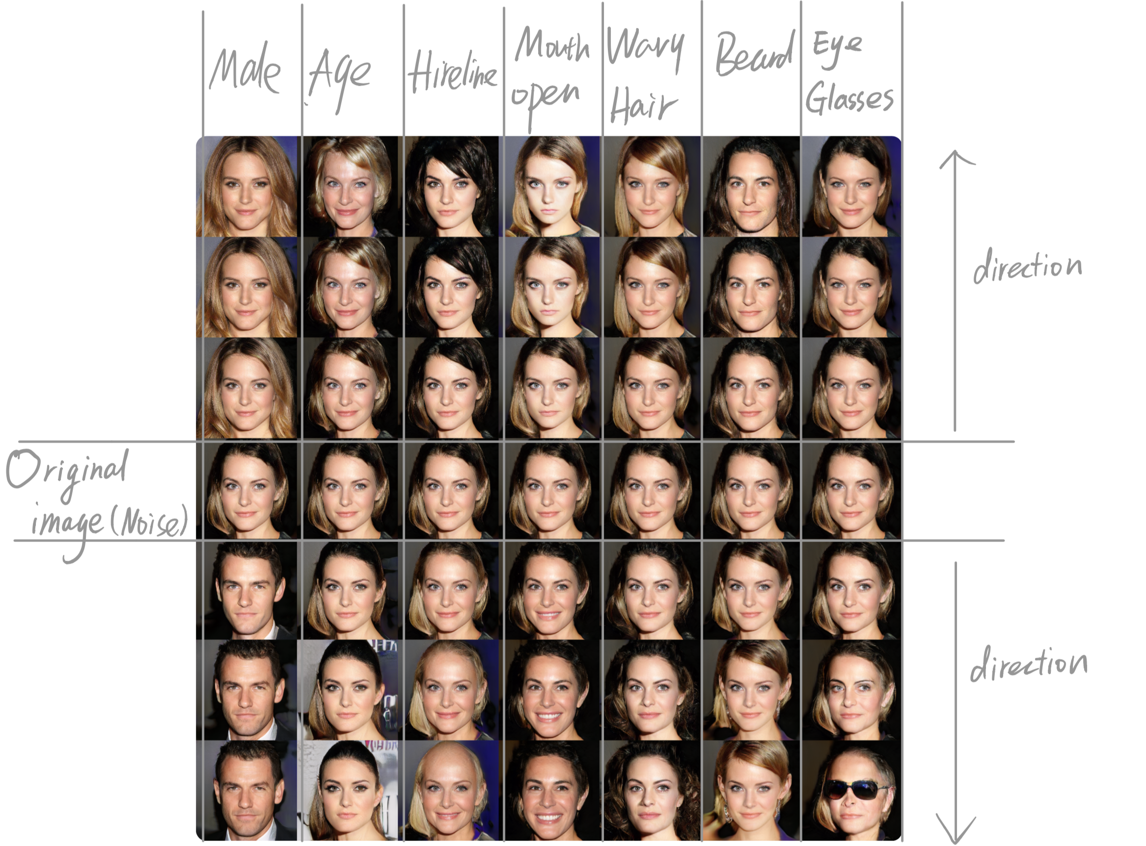
Notes:
Not just hair length, we can also change the image from male to female, from old to young, let the image open the mouth, change the color of her hair, put glasses on the image. We don’t just change the features; we actually control the features. As you can see, except for the gender column, all the images are very similar. They all come from the same noise and we just change the noise to a certain direction we want. Meanwhile,
Maybe someone find there is a problem, we fail to add beard to this woman. You can guess the reason. My friends will explain how to get this awesome results and where the problem come from.

Slide 14
Methodology
Notes:
the latent space of the gen. has two useful
it is well populated
it’s quite continuious

Slide 15
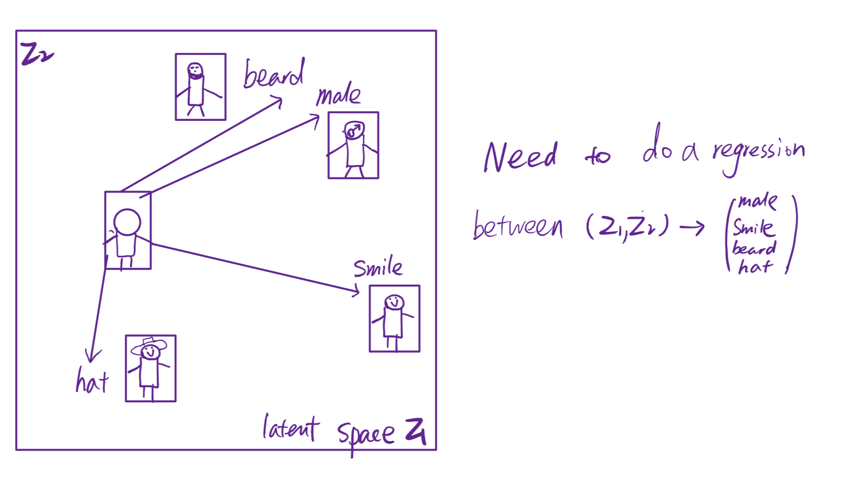
Notes:
Now the intuition is to find directions in latent space that are predictive of feature we care about.

Slide 16
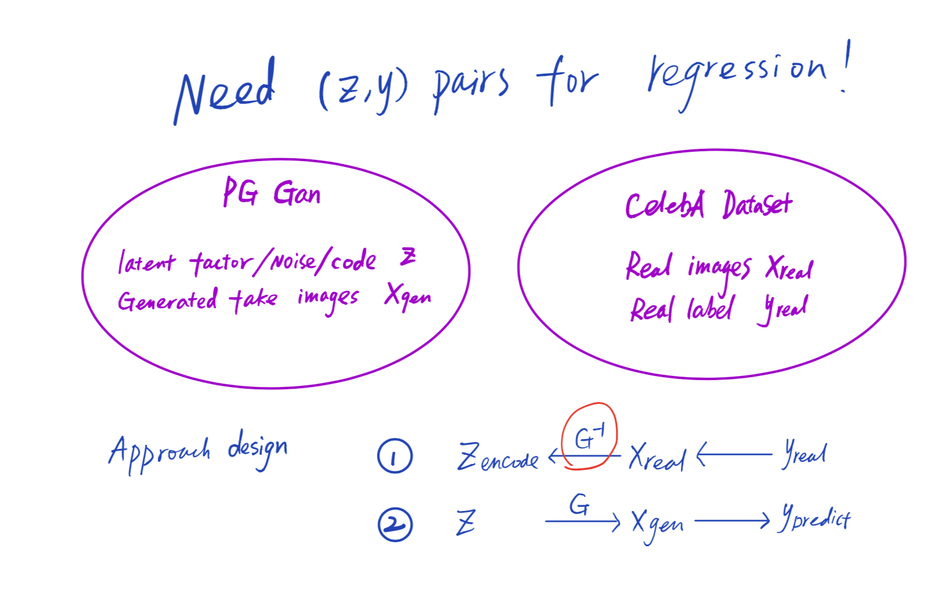

Slide 17
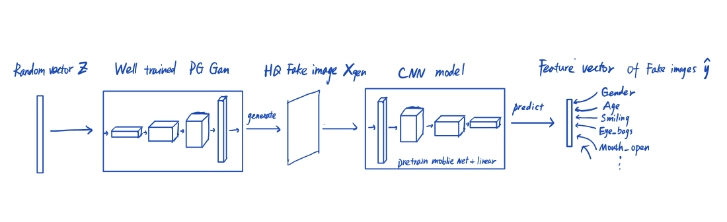

Slide 18
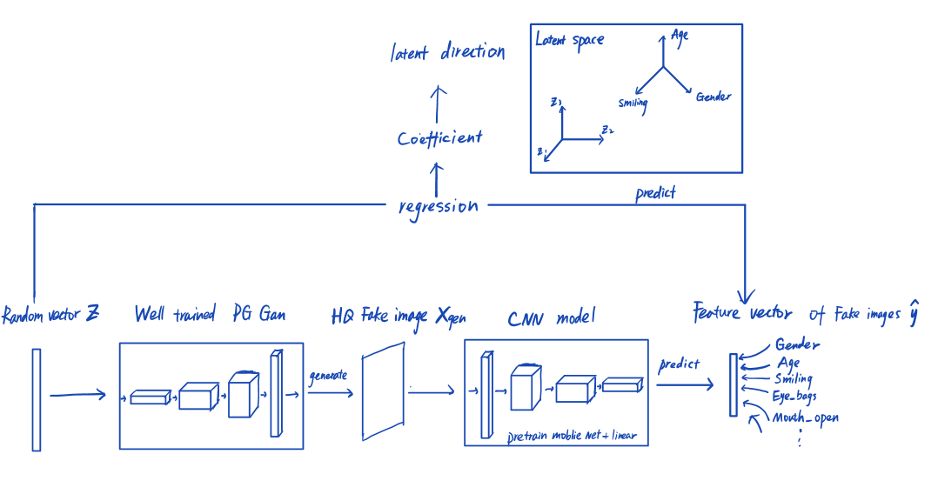

Slide 19
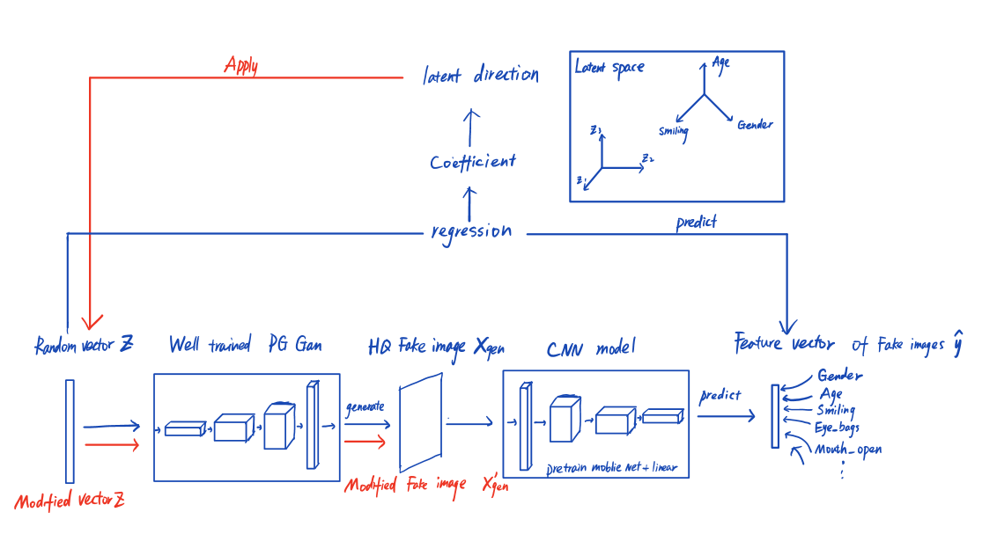

Slide 20
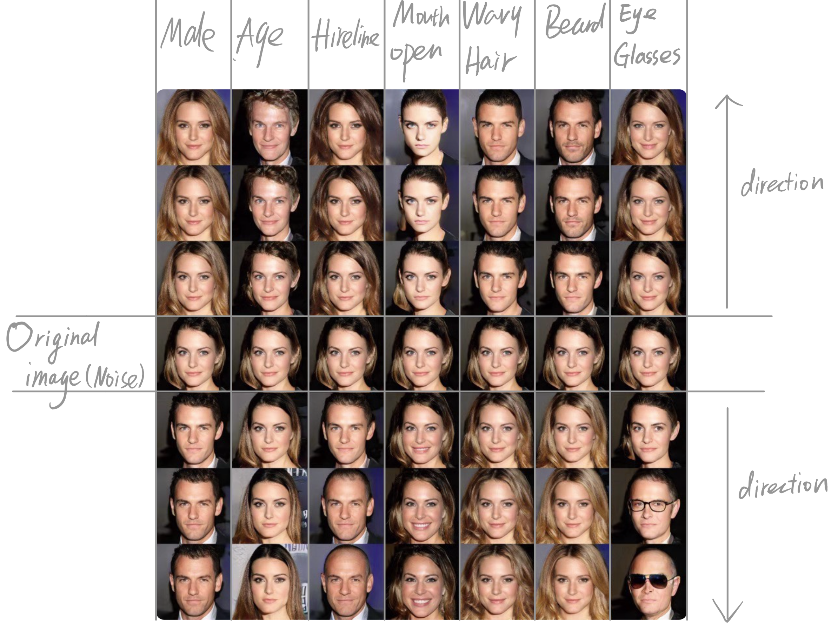

Slide 21
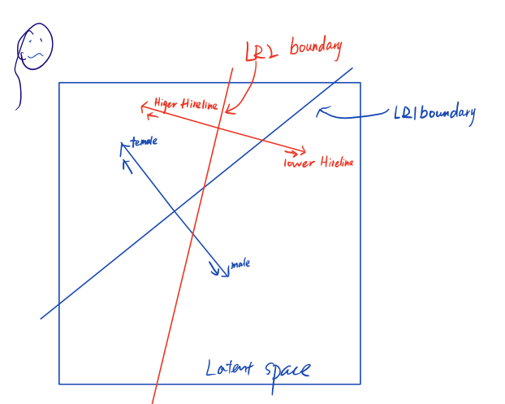
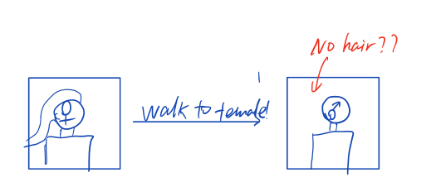

Slide 22
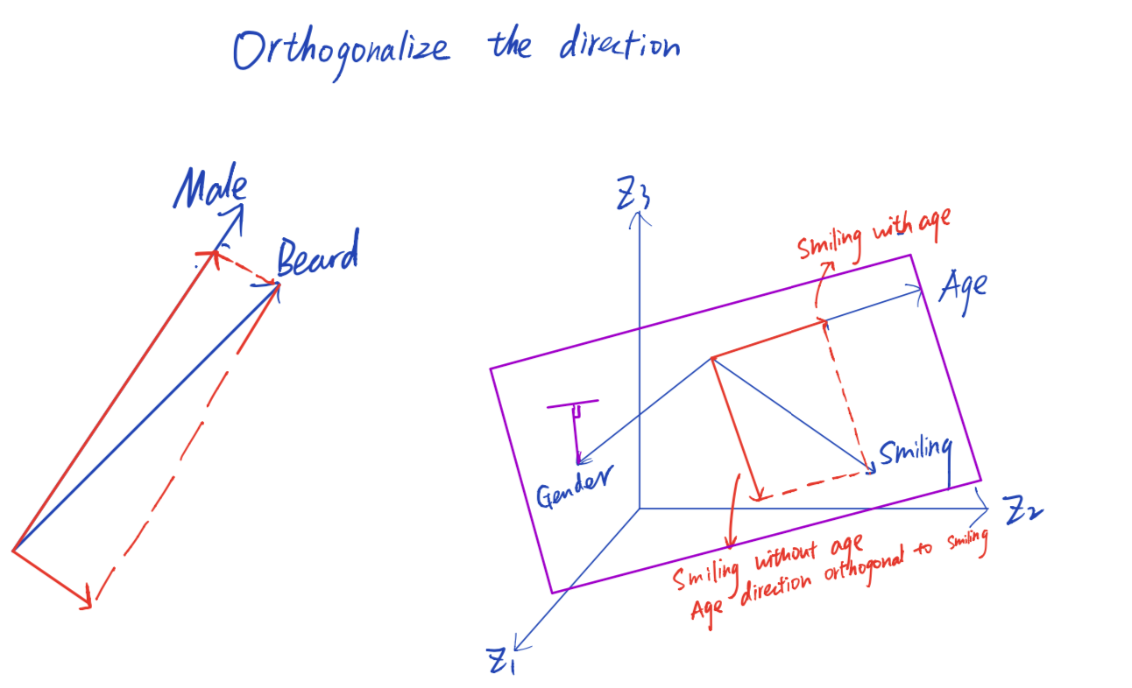

Slide 23
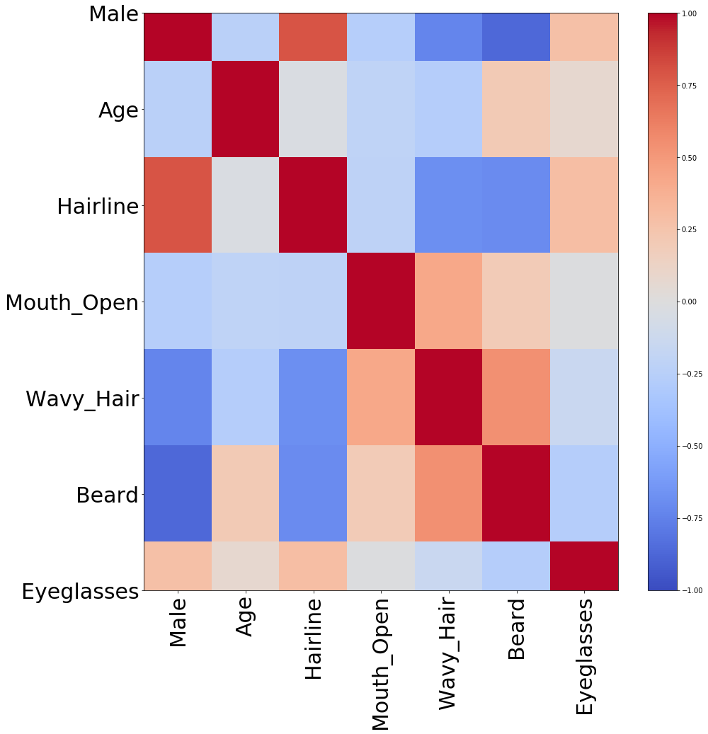
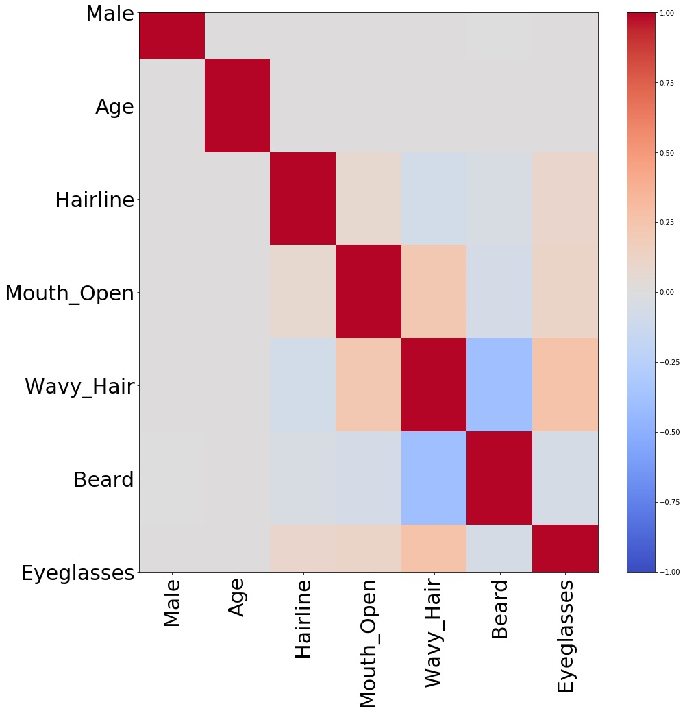
Before orthogonalize
After orthogonalize
Base (Male, Age)

Slide 25
Future work

Slide 26
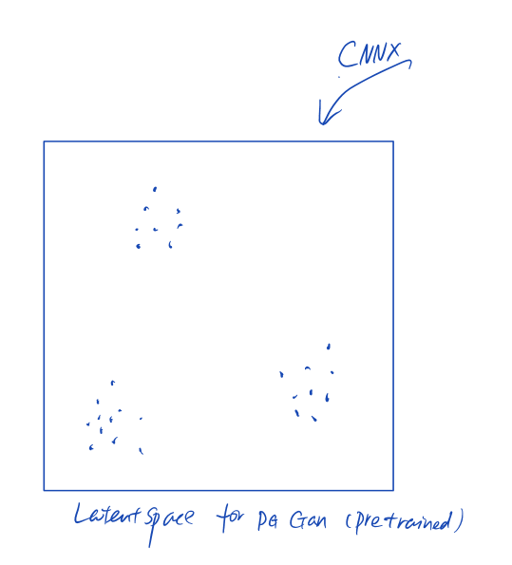
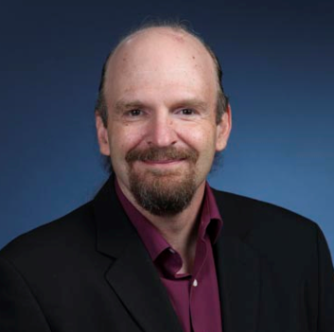
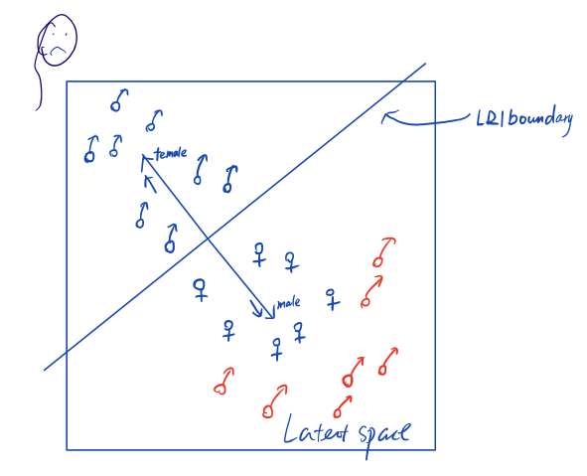
Direction could/should be Non-linear?
How to manipulate a specific portrait?

Slide 27
References
Creswell, Antonia and Bharath, Anil Anthony. Inverting the generator of A generative adversarial network. CoRR, abs/1611.05644, 2016. URL http://arxiv. org/abs/1611.05644.
Goodfellow, Ian, Pouget-Abadie, Jean, Mirza, Mehdi, Xu, Bing, Warde-Farley, David, Ozair, Sherjil, Courville, Aaron, and Bengio, Yoshua. Generative adversarial nets. In Ghahramani, Z., Welling, M., Cortes, C., Lawrence, N. D., and Weinberger, K. Q. (eds.), Advances in Neural Information Processing Systems 27, pp. 2672–2680. Curran Associates, Inc., 2014. URL http://papers.nips.cc/paper/ 5423-generative-adversarial-nets.pdf.
GUAN, Shaobo. Shaobo guan‘s post, 2018. URL https://blog.insightdatascience.com/generating-custom-photo-realistic-faces-using-ai
Karras, Tero, Aila, Timo, Laine, Samuli, and Lehtinen, Jaakko. Progressive growing of gans for improved quality, stability, and variation. CoRR, abs/1710.10196, 2017. URL http://arxiv.org/abs/1710. 10196.
Liu,Ziwei,Luo,Ping,Wang,Xiaogang,andTang,Xiaoou. Deep Learning face attributes in the wild. In Proceedings of International Conference on Computer Vision(ICCV), December 2015.

